Slide 1
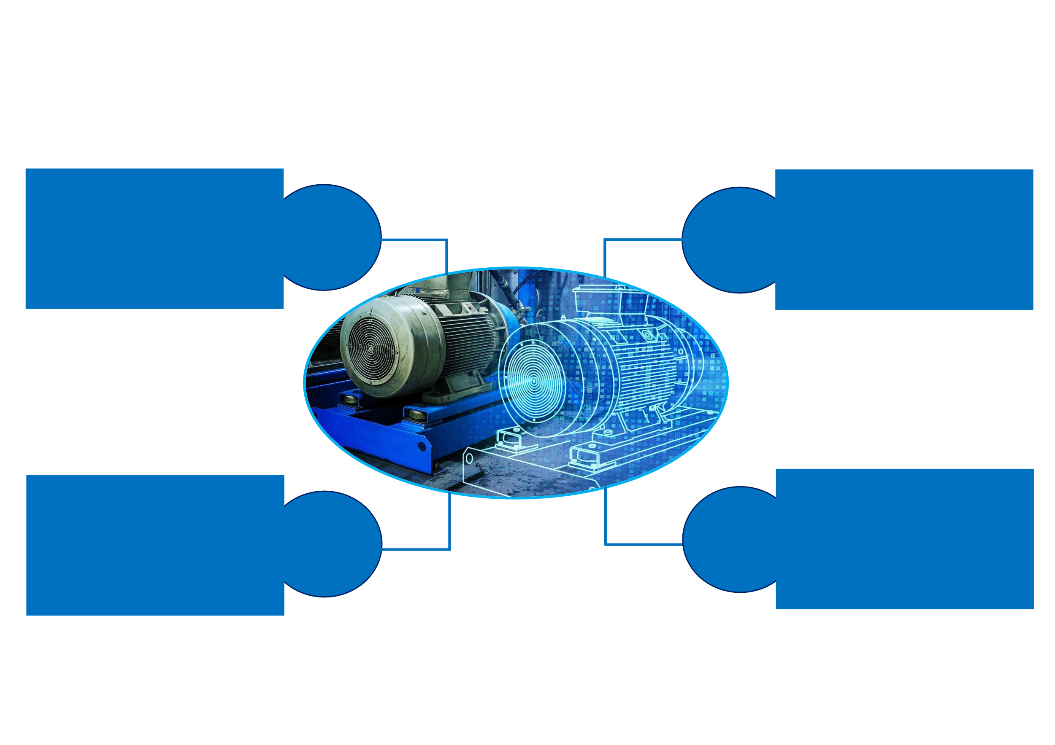
IoT sensors enable the real-time data transmission, which is used to create a digital duplicate of the real asset.
Data-driven modelling and tailored control strategies to enhance energy efficiency operation and provide grid support.
IoT
Modelling
&
Control
.
Cloud architecture allows access to the stored data from any location and enables to external computational capabilities
As Advanced analytical tool, AI analyze the data, offering real-time inference and condition monitoring.
Cloud
AI

